Slide 1

INTERNET PROGRAMMING & MOBILE PROGRAMMING
Mobile App
Development Process
Task 1 Report
Group 10
Asangana Paul Fleming • FE23A014
Fontem Junior Nkonganyik • FE23A063
Suinyuy Mathias Mahla • FE23A144
Nfor Godwill Kongnje • FE23A108

Slide 2

Overview
01
Introduction
Key Focus Areas
1
Application Types & Platforms
Digital Ecosystem Foundation
Mobile applications have become essential components of modern digital systems, fundamentally transforming how we communicate, learn, conduct business, and entertain ourselves in the contemporary world.
2
Programming Languages
3
Development Frameworks
Exponential Growth
4
Architecture Patterns
The rapid increase in smartphone usage worldwide has created unprecedented demand for efficient, scalable, and user-friendly mobile applications across all industries and demographics.
5
Requirement Engineering
6
Cost Estimation
Complex Development Landscape
Developing successful mobile applications requires deep understanding of application types, programming languages, frameworks, architectural patterns, requirement engineering, and cost estimation techniques.

Slide 3
02
Classification
Types of Mobile Applications
Native
PWA
Hybrid
Platform-Specific
Web-Based
Best of Both
Developed specifically for a single platform (Android or iOS) using platform-specific programming languages.
Web-based solutions that behave like mobile apps when accessed through a browser.
Combines elements of both native and web applications using web technologies in a native container.
Cost-effective cross-platform compatibility
High performance & reliability
Easy maintenance & deployment
Single codebase for multiple platforms
Full hardware access to device features
Uses standard web technologies
Reduced cost & development time
Ideal for gaming & financial systems
Faster time-to-market
Limitation: Limited device feature access & performance compared to native
Challenge: Separate development for each platform increases cost & time
Trade-off: Performance & UX may not match fully native apps
Selection Criteria: Consider performance requirements, budget constraints, timeline, and target audience when choosing the application type

Slide 4

03
Technology Stack
Programming Languages
Native Application Languages
The choice of programming language depends on the platform and development approach, directly impacting performance, development speed, and maintenance.
Android
iOS
Kotlin
Swift
Modern syntax, improved safety
Preferred, high performance
Java
Objective-C
Traditional, widely used
Legacy systems
Cross-Platform Languages
JavaScript
Dart
C#
Widely used for flexibility
High performance, rich UI
Enterprise integration
Framework: React Native
Framework: Flutter
Framework: Xamarin
Decision Factor: Each language offers unique advantages and trade-offs depending on project requirements, team expertise, and performance needs.

Slide 5
04
Tools & Libraries
Mobile Application Development Frameworks
Development frameworks provide essential tools and libraries that simplify and accelerate the application development process.
React Native
Flutter
Xamarin
JavaScript Framework
Dart Framework
C# Framework
Enables developers to build applications using JavaScript with near-native performance.
Uses Dart and is known for high performance and rich user interface capabilities.
Uses C# and is commonly used for enterprise applications with Microsoft integration.
Near-native performance
High performance
Microsoft integration
Strong community support
Rich UI capabilities
Native API access
Hot reload feature
Single codebase
Enterprise-focused
Large ecosystem
Customizable widgets
Code sharing
Best for: Flexibility & Ecosystem
Best for: UI & Performance
Best for: Enterprise Solutions
Selection Criteria: Performance requirements • Development speed • UI design needs • Developer expertise • Community support

Slide 6
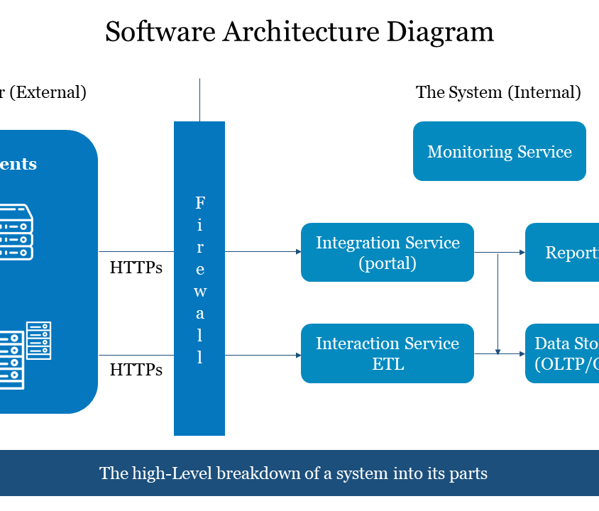
05
System Design
Architecture & Design Patterns
Architectural Patterns
Mobile application architecture defines how different components interact, ensuring code organization, reusability, and maintainability.
MVC
Model-View-Controller
One of the earliest patterns separating data, UI, and control logic.
Simple
Foundational
MVVM
Model-View-ViewModel
Introduces ViewModel separating UI from business logic, enhancing maintainability.
Testable
Maintainable
CA
Clean Architecture
Structured approach organizing app into layers, ensuring core business logic independence.
Layered
Scalable
Additional Design Patterns
Singleton
Factory
Observer
Single instance
Object creation
Event handling

Slide 7
06
Project Management
Requirement Engineering Process
A critical stage ensuring the system meets user expectations through systematic identification, analysis, and management of requirements.
1
2
3
4
5
Why It Matters
Gathering
Analysis
Documentation
Validation
Management
Ensures Quality
Collect information through multiple channels
Examine collected information systematically
Create clear, structured documentation
Ensure accuracy and completeness
Track changes throughout development
Systematic approach reduces errors
User Satisfaction
Aligns with user expectations
Formal descriptions
Accuracy check
Change tracking
Interviews
Functional reqs
Cost Efficiency
Surveys
Diagrams
Completeness
Version control
Prevents costly rework
Non-functional reqs
Use cases
Stakeholder alignment
Observation
Impact analysis
Time Savings
Prioritization
Clear requirements speed development
Key Insight: Well-engineered requirements are the foundation of successful mobile applications, directly impacting user satisfaction and project success.

Slide 8
07
Financial Planning
Cost Estimation
Cost Drivers
An essential part of project planning that helps predict overall costs and allocate resources effectively throughout the development lifecycle.
Complexity
Features
Simple apps are inexpensive; complex apps require more resources
Number and sophistication of features directly impact cost
Cost Components
Design
Platforms
Design
UI/UX, prototyping, graphics
iOS, Android, or both affect development effort
Custom UI/UX design requirements add to costs
Development
Coding, integration, features
Estimation Techniques
Testing
Expert Judgment
QA, bug fixes, optimization
Leveraging experienced professionals' insights and historical data
Analogous Estimation
Deployment
Comparing with similar past projects for baseline estimates
App stores, servers, launch
Bottom-Up Estimation
Breaking down into smaller components for detailed cost analysis
Maintenance
Updates, support, improvements
Important: Maintenance is particularly critical as applications require continuous updates to remain compatible with evolving technologies and user needs.

Slide 9
Conclusion
Mobile application development is a complex, multi-faceted process that requires careful consideration of numerous interconnected factors. Success depends on making informed decisions about application type, programming language, framework, architecture, and development methodology.
A structured approach that incorporates effective requirement engineering and accurate cost estimation ensures the successful delivery of high-quality applications that are efficient, scalable, and capable of meeting modern user demands.
Strategic Planning
Quality Assurance
User-Centric
Informed decisions at every stage
Structured development process
Meeting modern user demands
Thank you for your attention
Internet Programming & Mobile Programming • Task 1 • Group 10

